Slide 1
Database Analysis Fact-finding techniques
Based on Chapter 11

Slide 2
Objectives
The most commonly used fact-finding techniques.
How to use each fact-finding technique and the advantages and disadvantages of each.

Slide 3
Fact-finding techniques
It is critical to capture the necessary facts to build the required database application.
These facts are captured using fact-finding techniques.
The formal process of using techniques such as interviews and questionnaires to collect facts about systems, requirements, and preferences.

Slide 4
Fact-Finding Techniques
A database developer normally uses several fact-finding techniques during a single database project including:
examining documentation
interviewing
observing the organization in operation
research
questionnaires

Slide 5
Examining documentation
Can be useful
to gain some insight as to how the need for a database arose.
to identify the part of the organization associated with the problem.
To understand the current system.

Slide 6
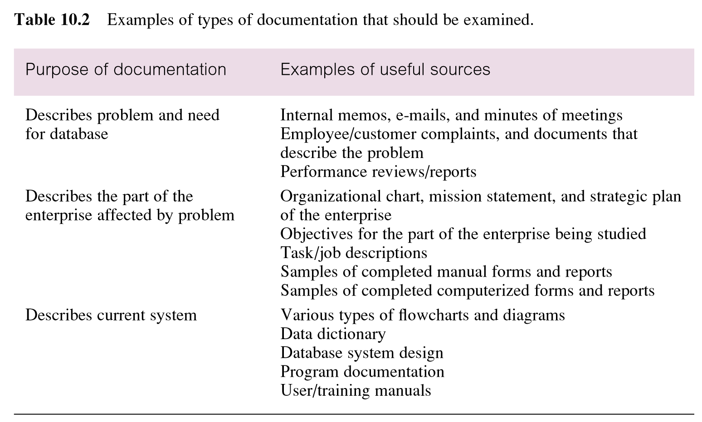
Examples of types of documentation that should be examined

Slide 7
Interviewing
Most commonly used, and normally most useful, fact-finding technique. Enables collection of information from individuals face-to-face.
Objectives include finding out facts, verifying facts, clarifying facts, generating enthusiasm, getting the end-user involved, identifying requirements, and gathering ideas and opinions.

Slide 8
Interviewing
There are two types of interviews unstructured and structured.
Open-ended questions allow the interviewee to respond in any way that seems appropriate.
Closed-ended questions restrict answers to either specific choices or short, direct responses.
Pearson Education © 2009

Slide 9
Observing the Organization in Operation
An effective technique for understanding a system.
Possible to either participate in, or watch, a person perform activities to learn about the system.
Useful when validity of data collected is in question or when the complexity of certain aspects of the system prevents a clear explanation by the end-users.

Slide 10
Research
Useful to research the application and problem.
Use computer trade journals, reference books, and the Internet (including user groups and bulletin boards).
Provide information on how others have solved similar problems, plus whether or not software packages exist to solve or even partially solve the problem.

Slide 11
Questionnaires
Conduct surveys through questionnaires, which are special-purpose documents that allow facts to be gathered from a large number of people while maintaining some control over their responses.
There are two types of questions, namely free-format and fixed-format.

Slide 12
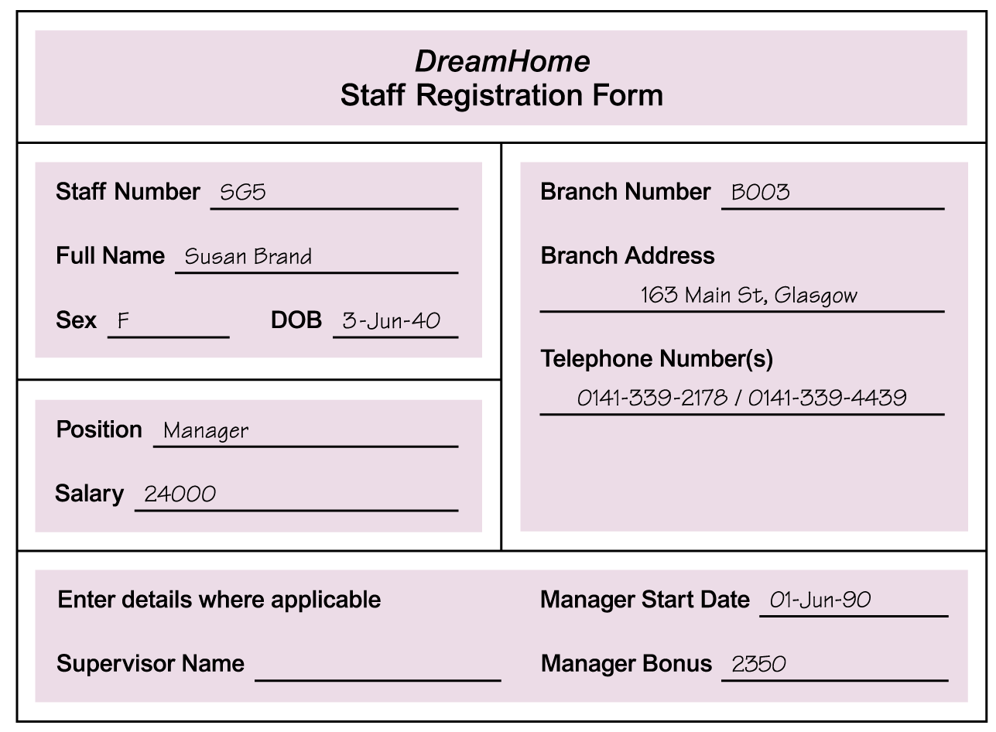
Study Documentation

Slide 13
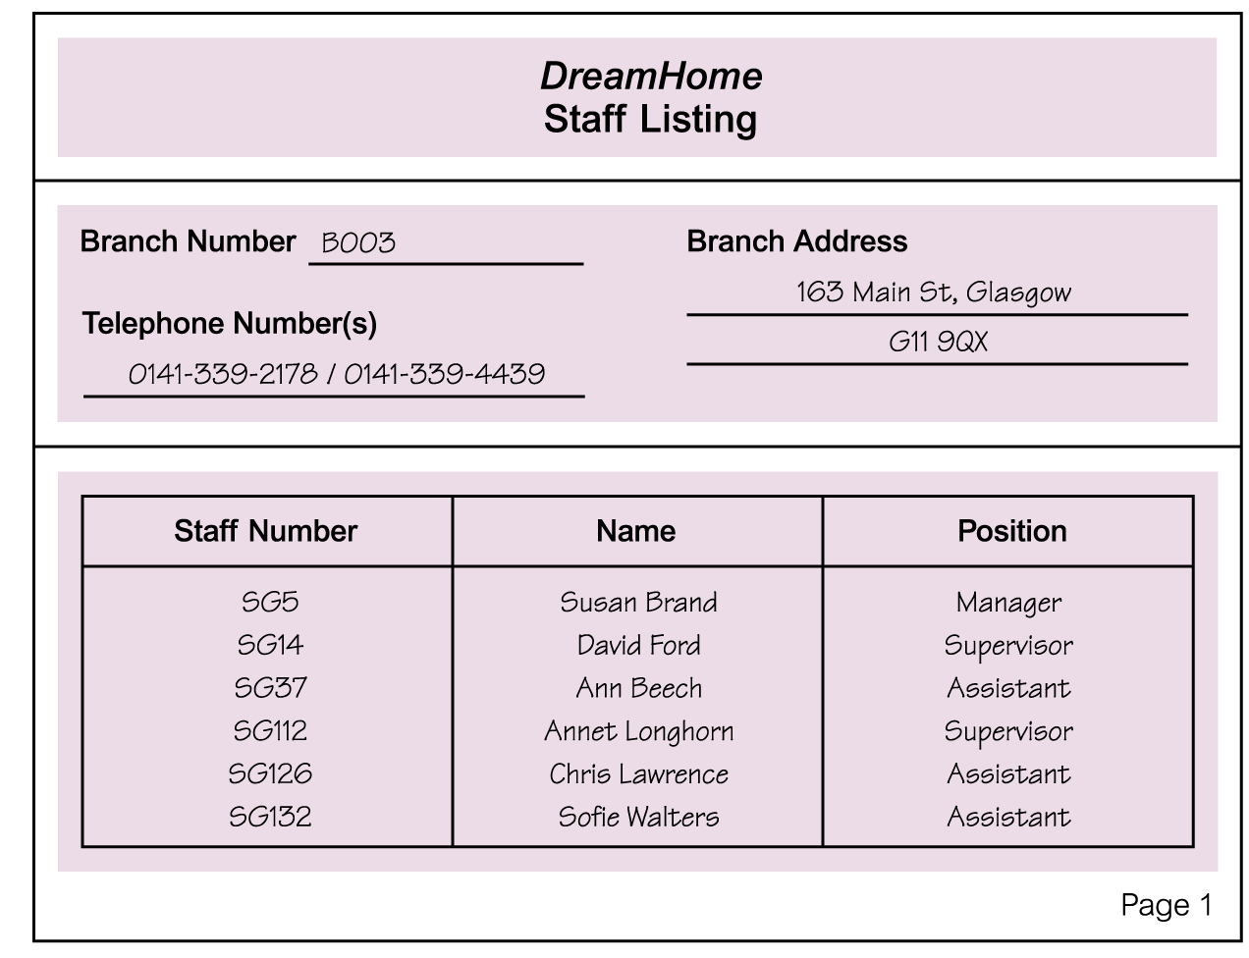
Documentation

Slide 14
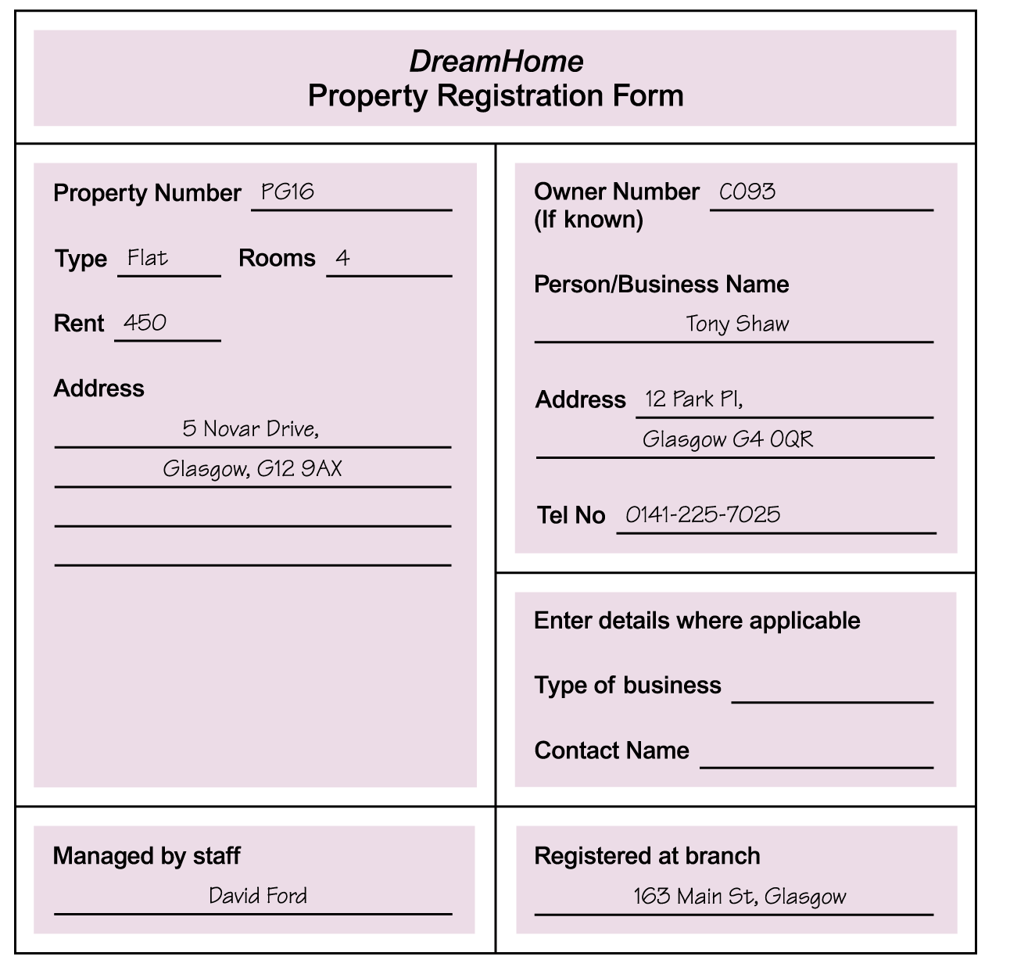
Using Fact-Finding Techniques – A Worked Example

Slide 15
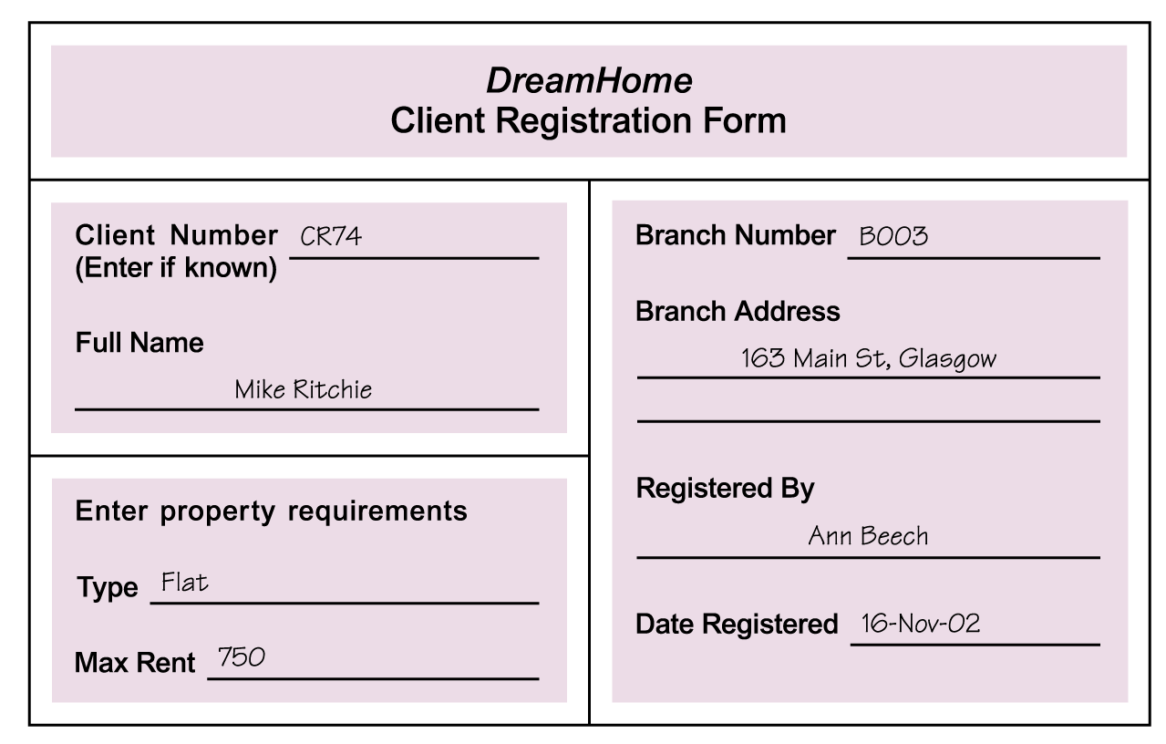
Using Fact-Finding Techniques – A Worked Example

Slide 16
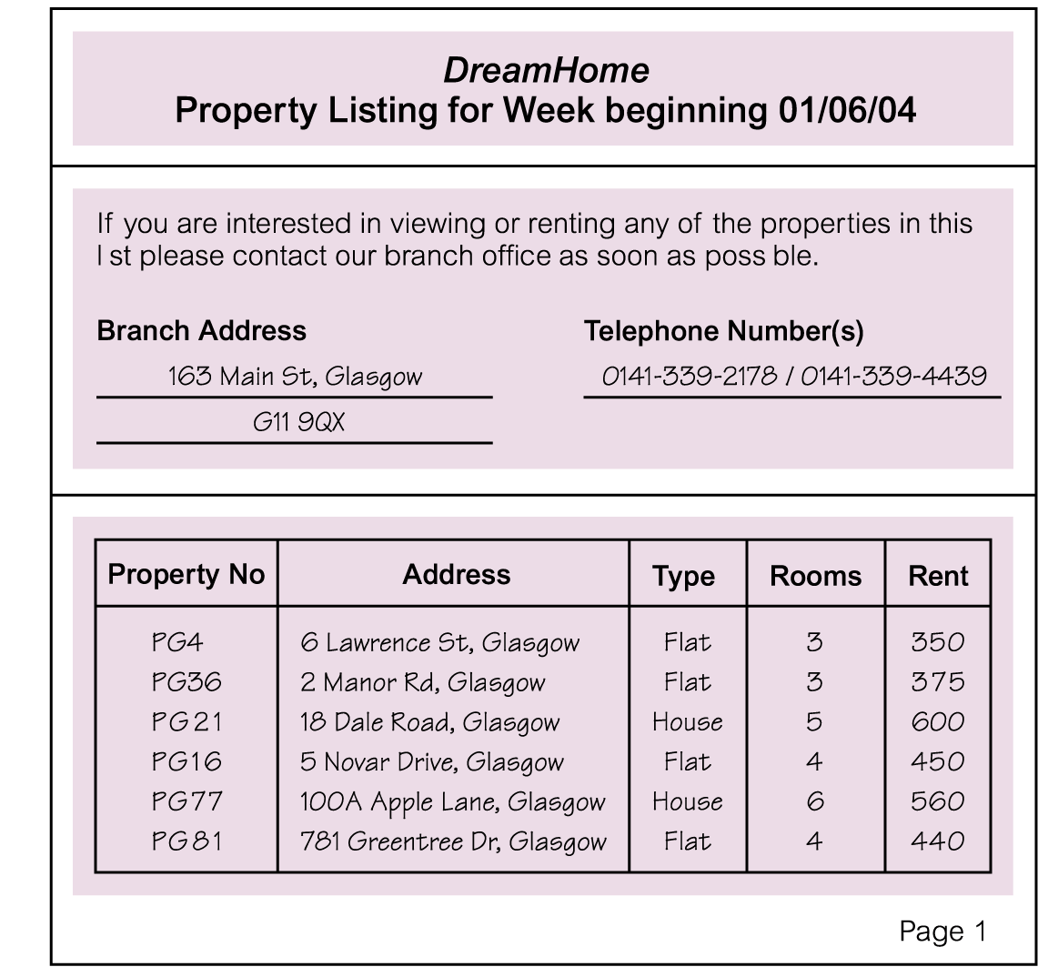
Using Fact-Finding Techniques – A Worked Example
Pearson Education © 2009

Slide 17
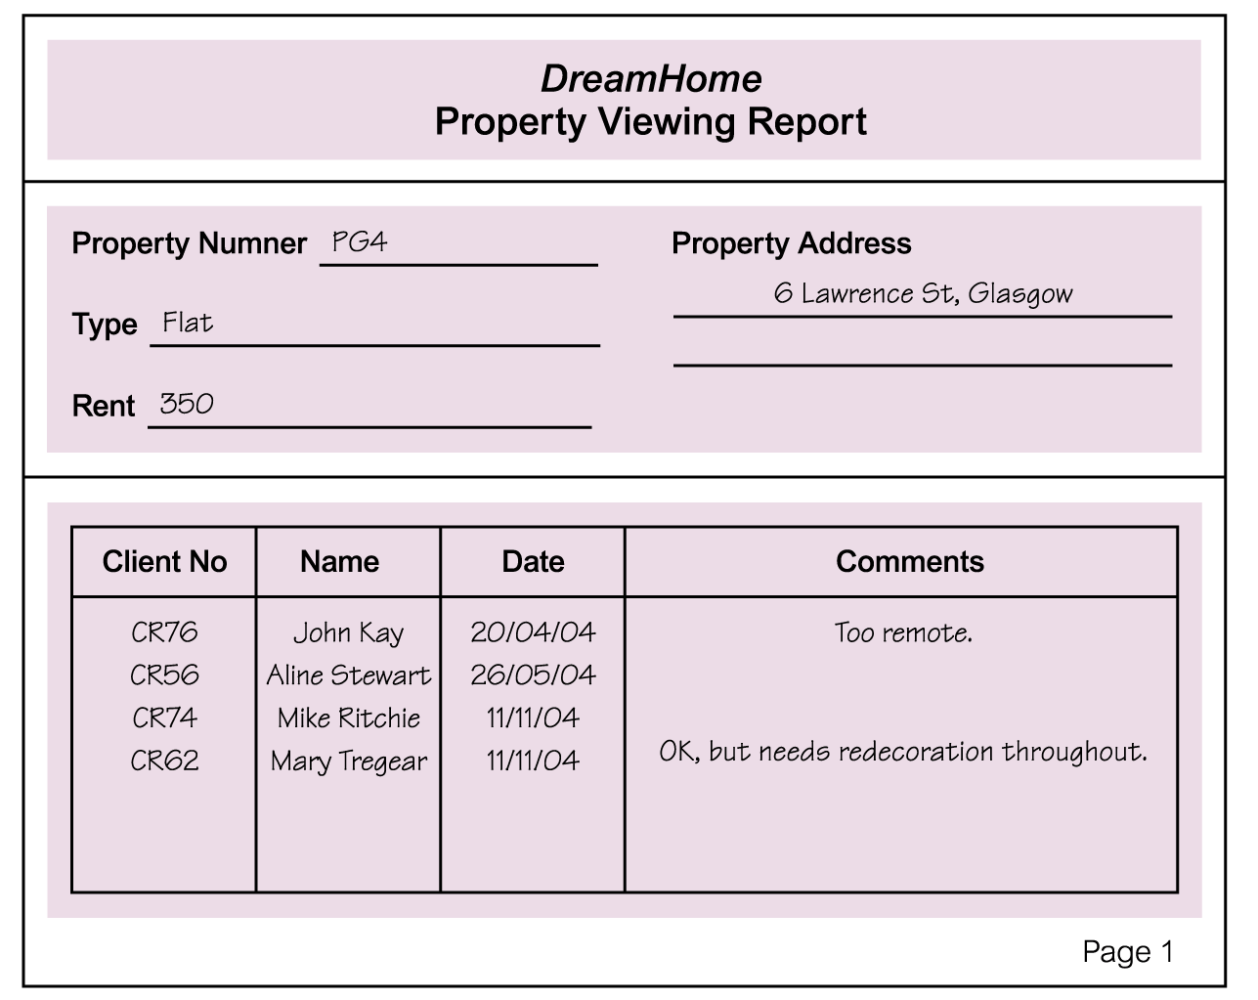
Using Fact-Finding Techniques – A Worked Example

Slide 18
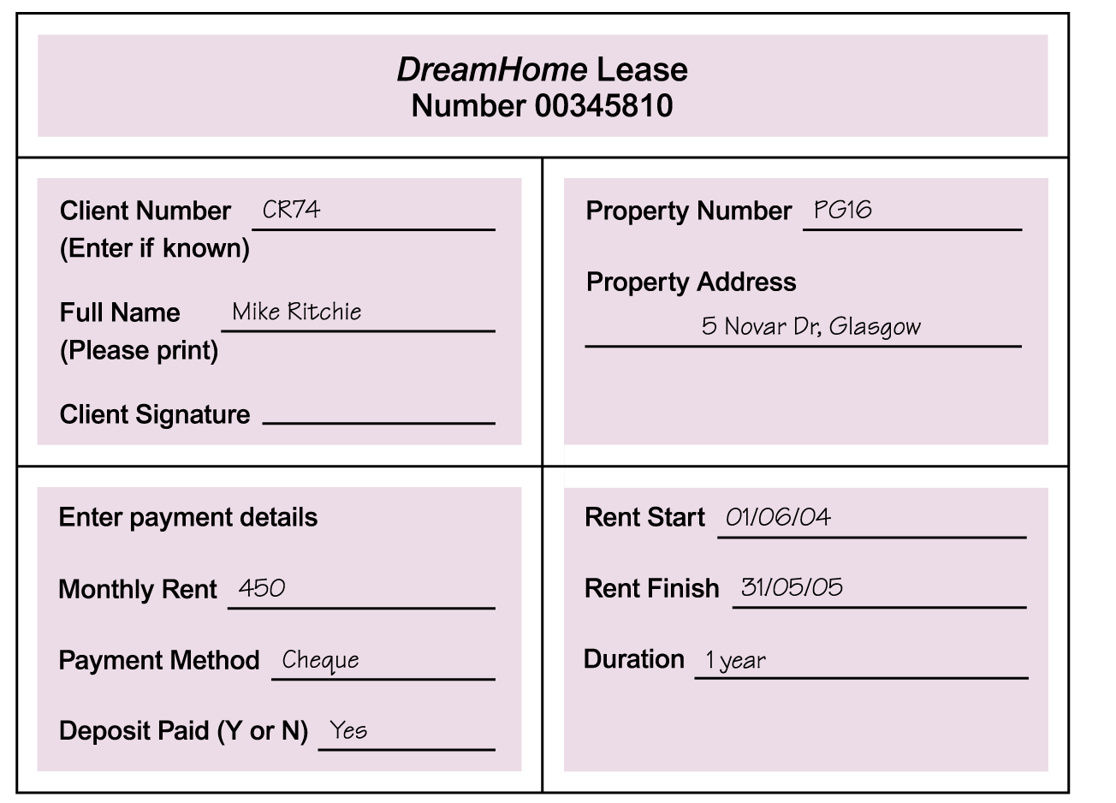
Using Fact-Finding Techniques – A Worked Example
Pearson Education © 2009

Slide 19
Mission Statement
What is the purpose of the database system?
TRU Library Mission Statement
Database mission statement and objectives

Slide 20
Objectives for Database System
To maintain (enter, update, and delete) data on…
To perform searches
To report ……
To support ….. Transactions
To track the status of ……

Slide 21
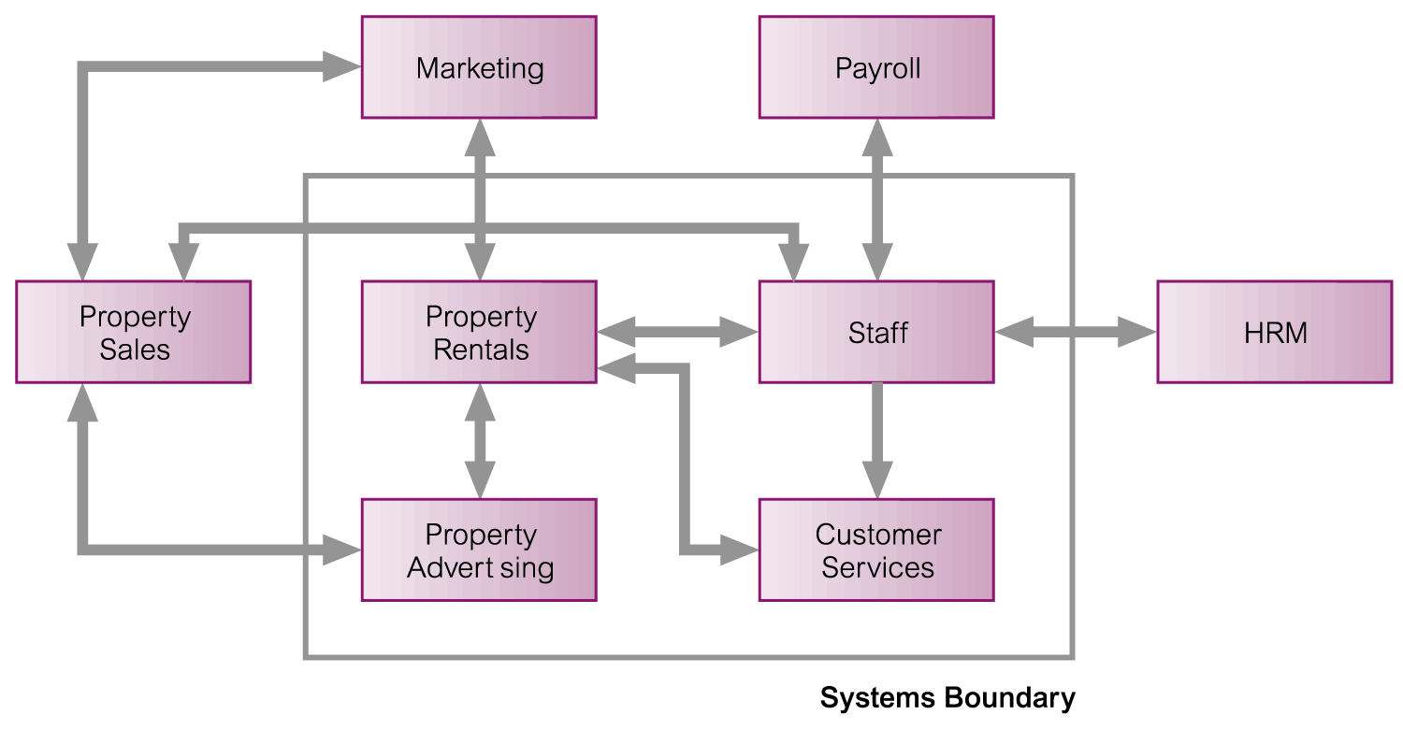
System Boundary for DreamHome Database System

Slide 22
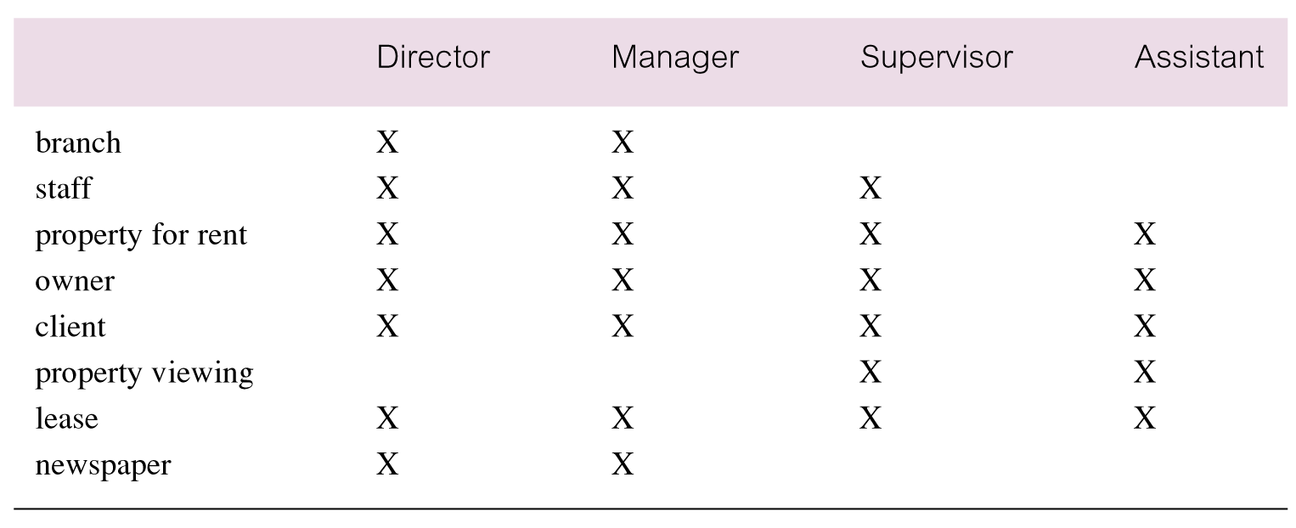
Cross-reference of user views with main types of data used by each

